Slide 1
3D Particle Diffusions
Shiyu Liu
Advisors: Dr. Hoa Nguyen, Dr. Orrin Shindell
Notes:
This project is inspired by Dr. Nguyen’s expertise in computational fluid dynamics along with Dr. Shindell’s expertise in thermal physics to try to simulate thermal motions of small particles In 3d space. First, I wanna introduce some of the basic

Slide 2
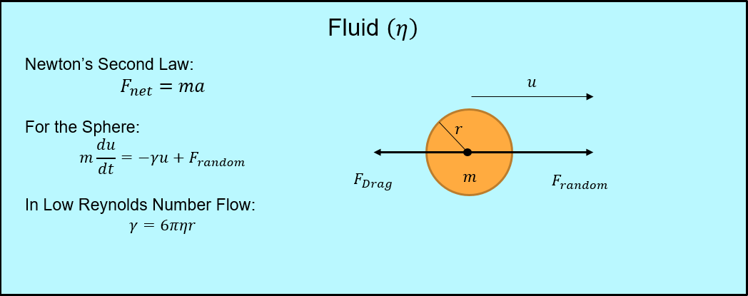
Brownian Motion
Notes:
The first idea is called brownian motion. You can imagine the orange circle be a small particle as a sphere in a 3d space with mass m and radius equal to r.
The particle is moving in a fluid with some viscosity. The particle is moving with a speed u, and the drag is the result of the resistance of the fluid putting the
Particle backward. In thermal motion, particles are also experiencing some random force in the system so in the picture the random force is prepuling the sphere
To move forward, and you have the resistant drag force that are pushing the particle backward.
Newton second low -> which you can turn into what is called the stokastic differential equation
Low reynold number means the inertial force of the mass is very small relative to the viscous force of the fluid; Drag coefficient

Slide 3
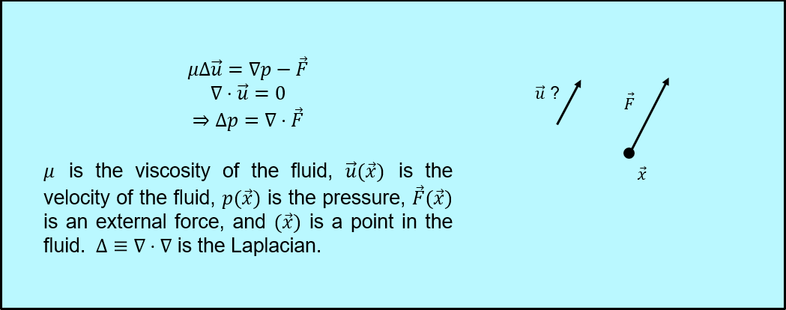
Stoke Flows
How to simulate the process of Brownian motion computationally
Notes:
How do we simulate this type of situation computationally. We used the stokes equations, which tells you basically how the fluid moves, and it is the simplified set of equations
Derived from low reynolds equations.The problem boils down to how to computationally solve those set of equations. The triangle is the divergence of the gradient
The gradient of the velocity equal to 0 is quite important in our calculation. It means that whatever fluid we are considering is incompressible, it is always the same density in any
Region of consideration.

Slide 4
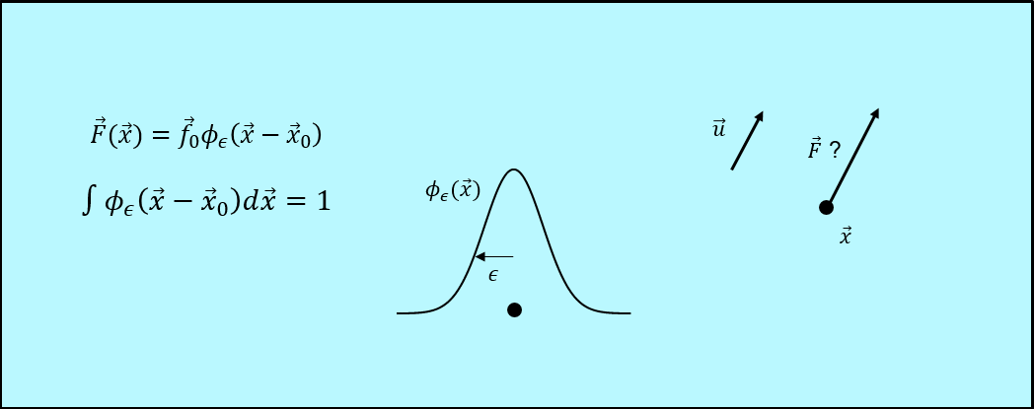
Method of Regularized Stokeslets (MRS)
Cortez, R., Fauci, L., & Medovikov, A.S. (2005). The method of regularized Stokeslets in three dimensions: Analysis, validation, and application to helical swimming. Physics of Fluids, 17(3) 031504
Notes:
So we are using the regularized stokelets to perform those calculations.
So if we only consider one single point force and try to calculate the flow. You would get divergents, which means you will get infinities all over the place, which is not ideal.
So to avoid this problem we use regularized stokelets, basically instead of consider the force in a infinitely small single point, we spread the force over some region.
The region is determined by a normal distribution curve. With epsilon what we called the blob size to control the distribution of the force. Since the force is represented by
The area under the curve and the area always sum to one, as you increase the blob size, the width gets larger and you have smaller height, vice versa.
The important takeaway from this is that when you have a particle moving in the fluid, the radius is somehow related to the blob size, and it is important for us
To first figure out this relationship.

Slide 5
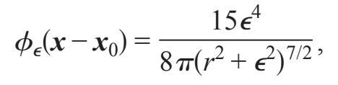
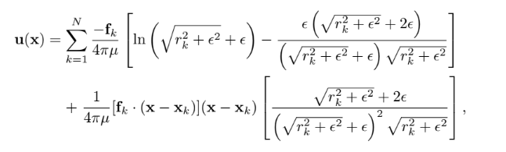
MRS
Blob function
Due to the linear relationship between force and velocity, this formula can be written as
U = MF

Slide 6
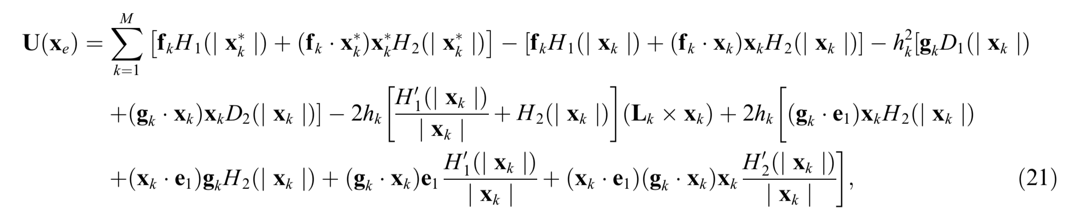
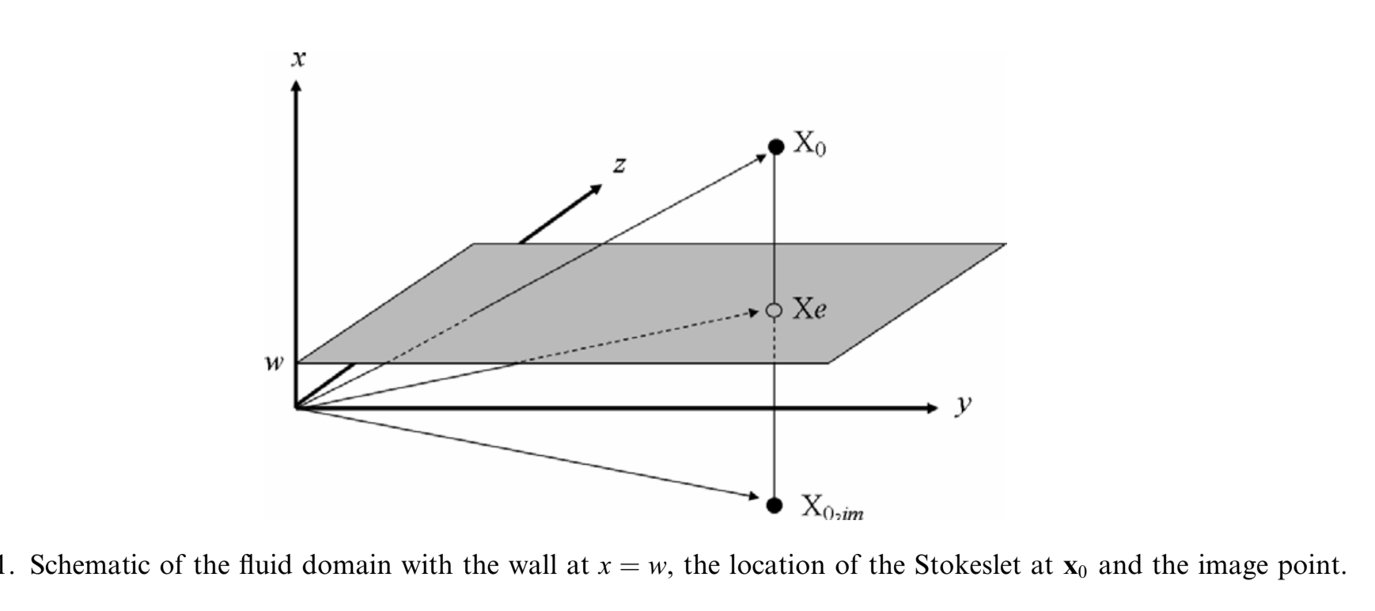
Method of Images for Regularized Stokeslets (MIRS)
Due to the linear relationship between force and velocity, this formula can be written as
U = MF
Ainley, J., Durkin, S., Embid, R., Boindala, P., & Cortez, R. (2008). The method of images for regularized Stokeslets. Journal of Computational Physics, 227(9), 4600–4616.

Slide 7
Flowchart
Simulating Brownian motion of particle in 3D with time
Plot density distribution for positions in each time
Calculate Matrix M
Get a random force F
U = M*F
(M <- MRS || MIRS)
N particles/simulation vs.
1 particle/simulation for N simulations
MRS vs. MIRS
Update particle position

Slide 8
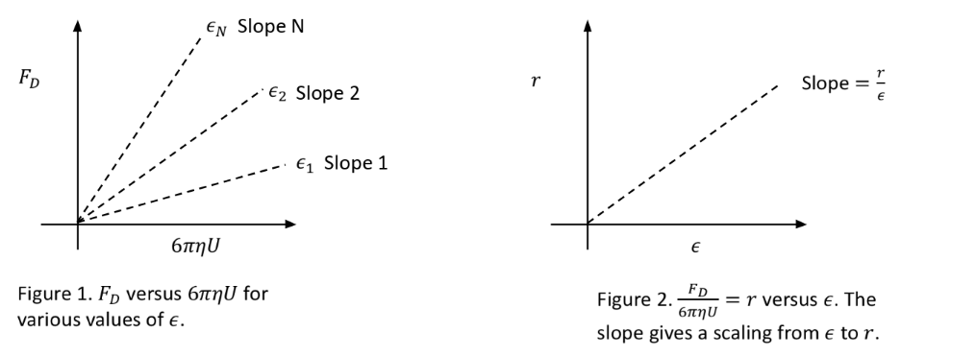
Notes:
Like what we have discussed before, the blob size is in someway tied to particle radius. In our calculation we assume those are equal, To match with theoretical calculation,
We have to determine the relationship between blob size epsilon and the radius.

Slide 9
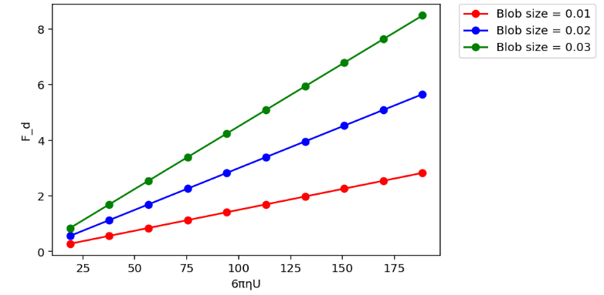
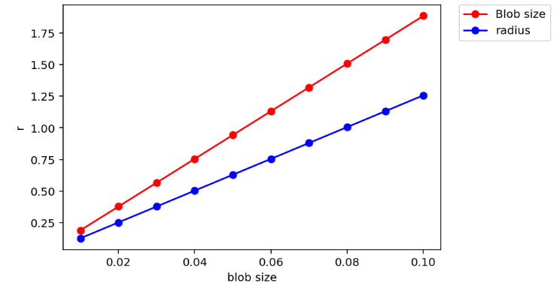
Result
Blob size ε = 1.5r where r is the radius of a particle.

Slide 10

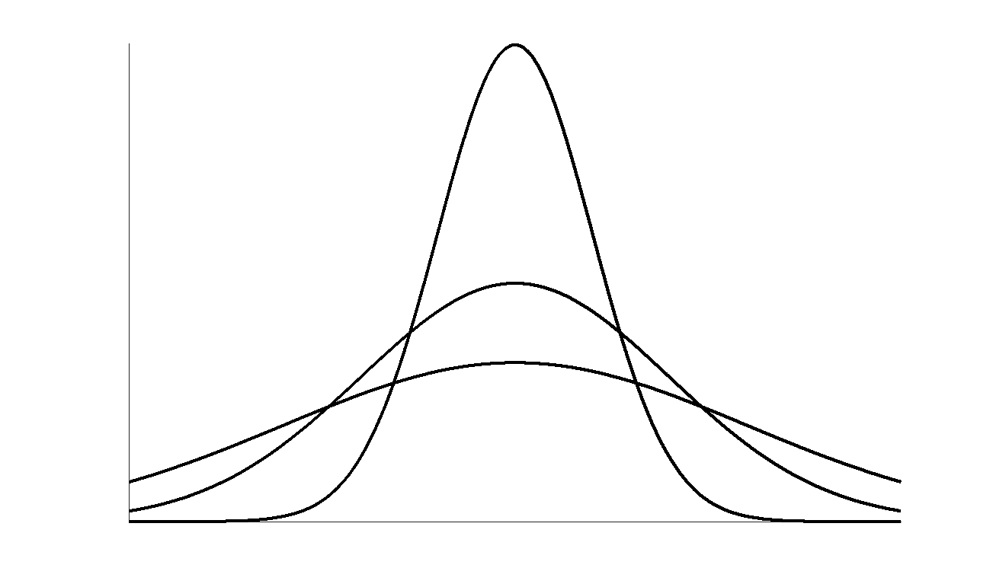





2. Simulate Brownian Motion
Notes:
The second step is once we have the drag coefficient figured out we can impose the randomness to the stochastic differential equations we ve been talking about. We can then develop
The probability distribution of the particles at each time step,

Slide 11
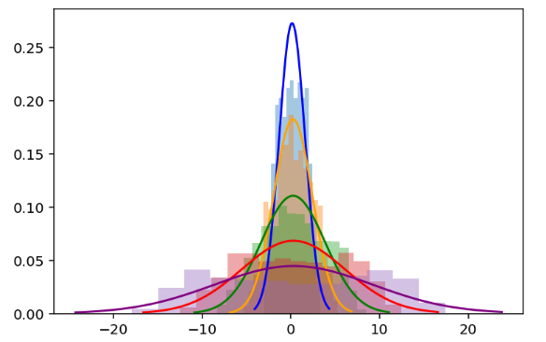
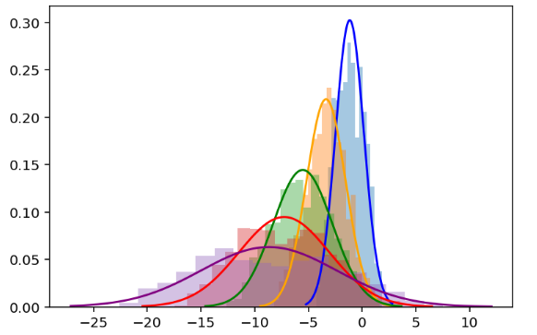
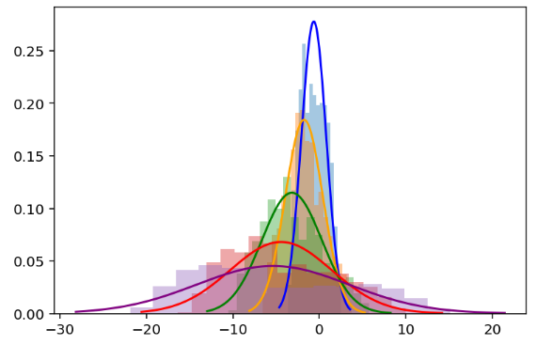
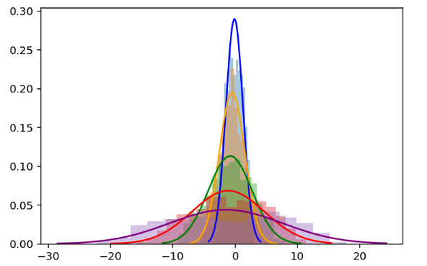
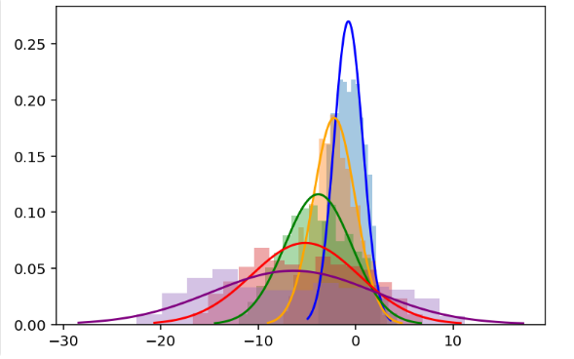
Results for N particles/simulation using MRS (no surface)
Notes:
Two time series

Slide 12
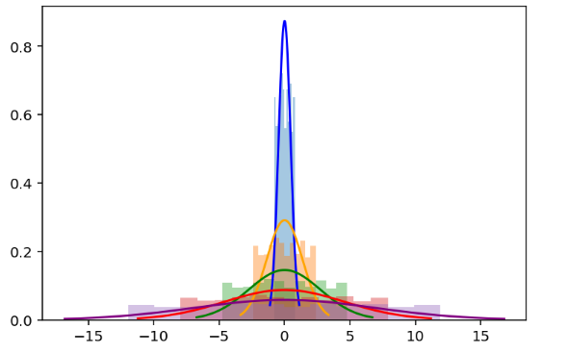
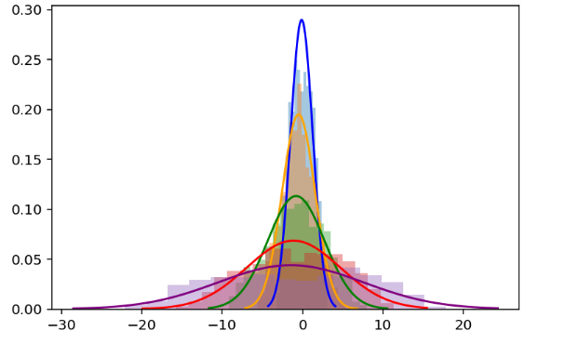
Results for 1 particle/simulation with N simulations
using MRS (no surface)
1 particle N simulations
N particles
Notes:
Graph 1 is the 1 particle. Graph 2 is the 1 particle for n runs.
For one particle n runs seems to always have higher concentration in the middle, where for N particles at each they have
less concentrated in the center and apparently move further away from the origin.

Slide 13







3-D Task 3: Impose Surface Hydrodynamic Interactions
Surface
Notes:
Task three we move further along, that instead of assuming that all our particles are moving in a free 3d space, getting knocked around equally in all directions, we consider the
Particles in an environment with a nearby surface. When you come near to a surface, the drag force will be modified because the closer you are to the surface the larger the drag
Becomes. Obviously those particles wont be able to pass the surface, and we wonder that with the presence of the wall, whether it is going to change the distribution of all the particles

Slide 14
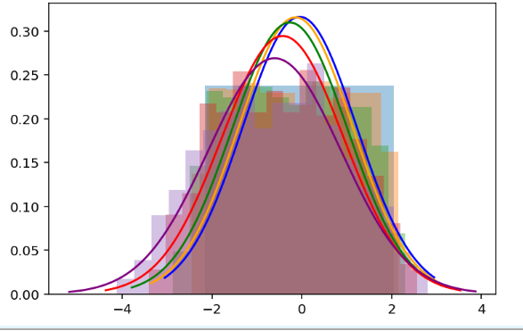
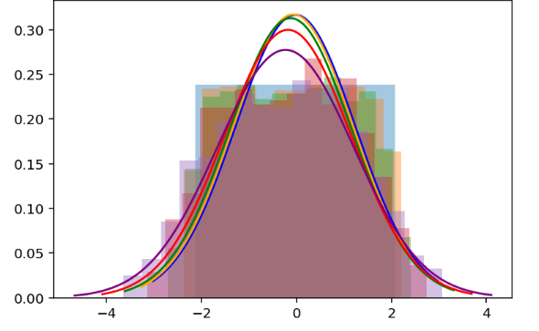
Results for N particles/simulation using MIRS
(density distribution in the y; surface at -2.5 x)
Notes:
Two time series

Slide 15
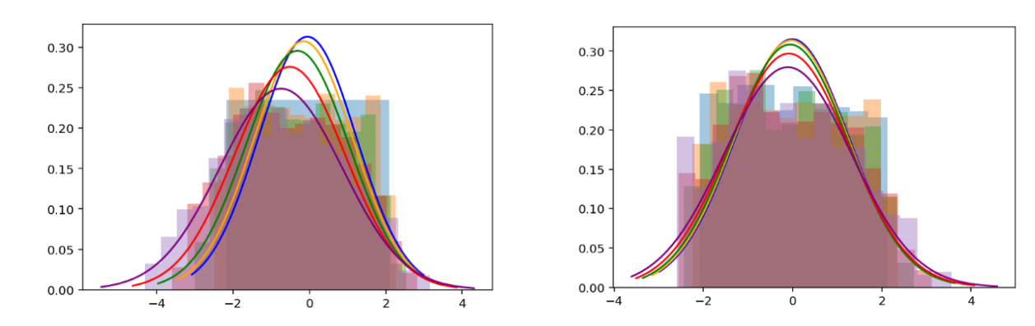
Results for N particles/simulation using MIRS
(density distribution in the x direction; surface at x = -2.5)
Notes:
Two time series

Slide 16
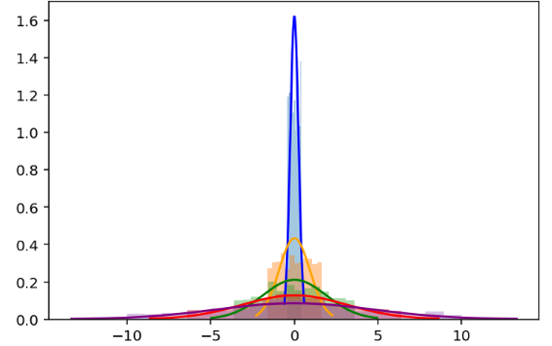
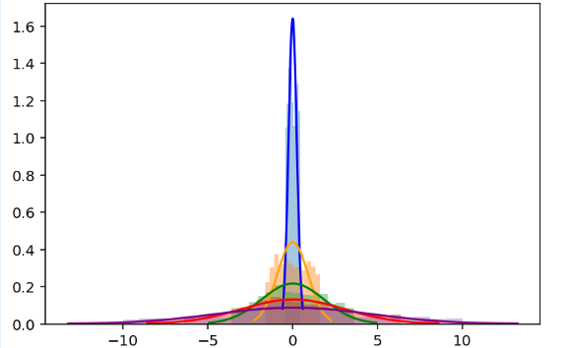
Results for 1 particle/simulation with N simulations
using MIRS (density distribution in the y or z direction; surface at x = -1)
Y axis
Z axis
Notes:
Graph 1 is the N particle. Graph 2 is the 1 particle for n runs.
For one particle n runs seems to always have higher concentration in the middle, where for N particles at each they have
less concentrated in the center and apparently move further away from the origin.

Slide 17
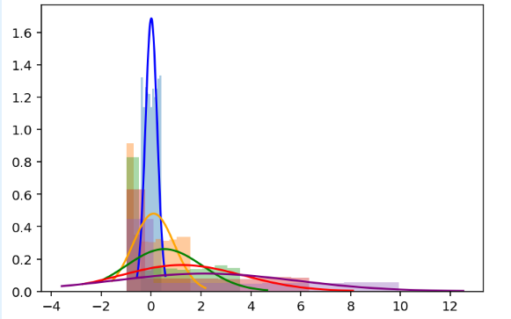
Results for 1 particle/simulation with N simulations
using MIRS (density distribution in the x direction; surface at x = -1)
Notes:
Graph 1 is the N particle. Graph 2 is the 1 particle for n runs.
For one particle n runs seems to always have higher concentration in the middle, where for N particles at each they have
less concentrated in the center and apparently move further away from the origin.

Slide 18

Conclusion 1: Surface Effect
(No Particle-Particle Interactions)
1 particle/simulation for N simulations (density distribution in the x direction)
MRS (infinite 3D space)
MIRS (surface at x = -1)
Notes:
. I would see the trend is quite similar yet has some subtle differences. Obviously you see that no particles pass the wall. You also see higher concentration close to wall.
The wall also influences how fast particles are spreading. Without the wall the distribution near the center is below 0.25 while with the wall it is still well beyond 0.25

Slide 19
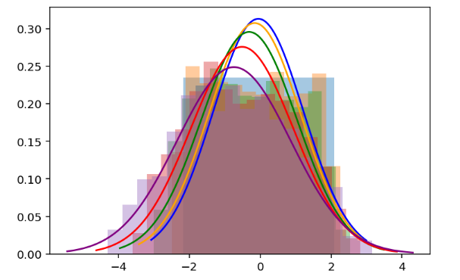
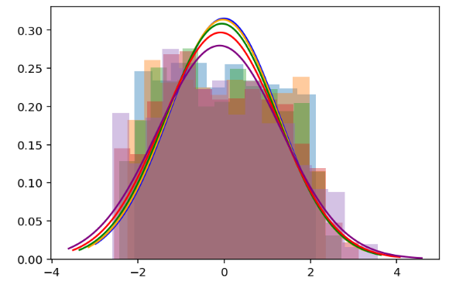
Conclusion 2: Surface Effect and
Particle-Particle Interactions
N particles/simulation (density distribution in the x direction)
MRS (infinite 3D space)
MIRS (surface at x = -2.5)
Notes:
. I would see the trend is quite similar yet has some subtle differences. Obviously you see that no particles pass the wall. You also see higher concentration close to wall.
The wall also influences how fast particles are spreading. Without the wall the distribution near the center is below 0.25 while with the wall it is still well beyond 0.25

Slide 20
Lessons & Future directions
Time management
Communication with advisors regularly
Similarity to machine learning
Future directions
Realistic random force
Further applications

Slide 21
Acknowledgement
Nicholas Coltharp
Dr. Shindell
Dr. Nguyen
Dr. Lewis for coming today!

